Slide 1
SURVIVAL PLOTS FOR SURVEY
VR

Slide 2
BACKGROUND
Time-to-event analysis “survival analysis” is a key area of statistics that has several applications in clinical practice, for instance, in the management of Noncommunicable diseases, to understand survival time, time to recurrence, or relapse.
This survey aims to understand clinicians’ preferences in visualizing survival data.
There will be 3 types of survival plots: Kaplan Meier, survival ratio, and survival difference plots. The same data is displayed differently. We would like to know your preference among the 3 plots. Interpretations will be provided.
This study is conducted by Victor and Shyam in fulfillment of MSc in health data science at the University of Galway.
All the responses are anonymous and Participation is voluntary. It will take 5 min
Your input is highly valued, and we appreciate your time in completing this survey.
For more information: v.rwandarwacu1@universityofgalway

Slide 3
DATASET DESCRIPTION
The TCGA BRCA (The Cancer Genome Atlas Breast Invasive Carcinoma) is a publicly available resource,
The clinical dataset provides comprehensive patient-level clinical information to support breast cancer research. It includes key variables such as demographics, tumor characteristics (pathologic TNM staging, histologic type, hormone receptor status), treatment details, survival outcomes, and recurrence status.
This dataset enables the analysis of prognostic factors, survival patterns, and treatment responses, making it a valuable resource for understanding clinical outcomes in breast cancer.
This data set will be used to visualize survival among patients with different pathologic stages.

Slide 4
Comparison of survival between Pathologic stage II and III of Breast Cancer

Slide 5
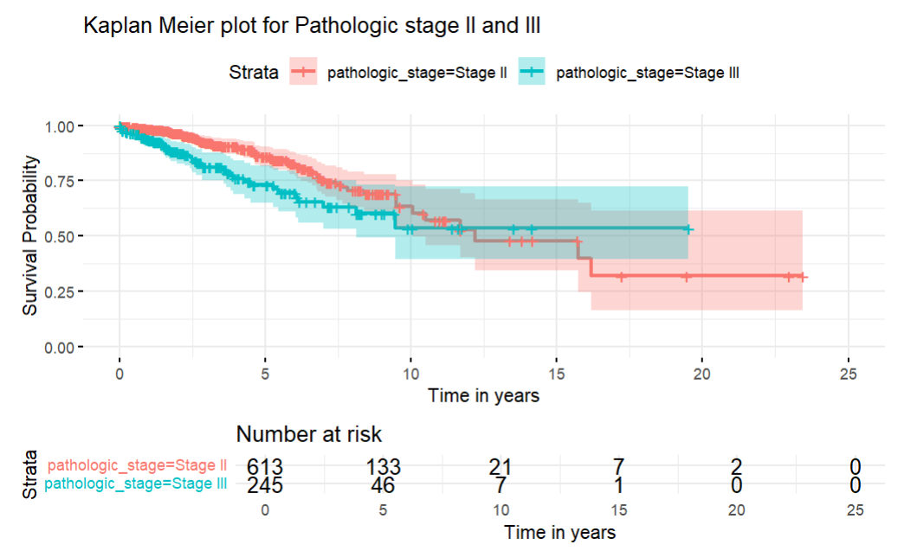
KM Plot :Pathologic stage II and III
KM plot compares survival probabilities for patients with breast cancer pathologic stage II and III, and the table at the lower end includes number of people still alive at each time interval.
Initially, there is a steep decline in survival for pathologic stage 2 compared to stage 3,(indicating a worse prognosis for group 3 ) . Around 12 years both group has equal survival probability.
The shaded areas represent confidence intervals, which widen over time due to fewer patients remaining at risk, increasing uncertainty(imprecision) in survival estimates.

Slide 6
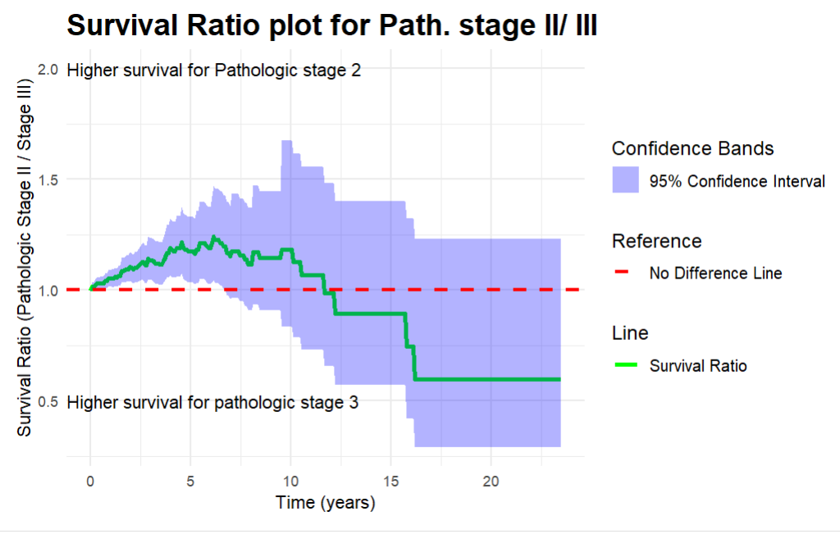
Survival ratio plot: Pathologic stage II vs III
The survival ratio plot compares the relative survival between patients with pathologic stage II and stage III cancer over time, where a value above 1 indicates higher survival for stage II and below 1 favors stage III.
Initially, the survival ratio is close to 1, but over time, the green line remains above no difference line, suggesting that patients with stage II cancer have a better prognosis compared to those with stage III.
The purple-shaded region represents the 95% confidence interval, which widens over time due to fewer patients remaining at risk, increasing uncertainty in the estimation of prognosis.
Around 10 to 15 years, the survival ratio drops closer to 1 and below, indicating that survival differences between the two stages decrease, but overall, stage II maintains a survival advantage over stage III

Slide 7
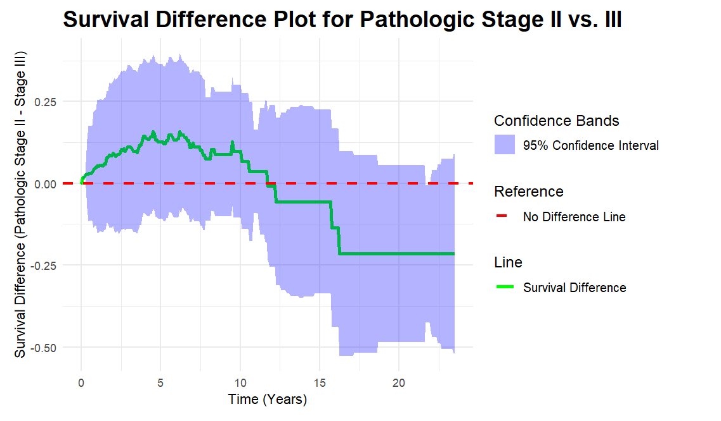
Survival difference plot: Pathologic stage II vs III
This plot compares the absolute difference in survival probabilities between pathologic stage II and stage III cancer over time, with positive values indicating better survival for stage II.
The green survival difference line remains above the no-difference line for most of the timeline, indicating that stage II patients generally have better prognosis than stage III patients.
The shaded purple region represents the 95% confidence interval, which widens as time progresses, reflecting increased uncertainty(imprecision) due to fewer patients at risk.
After approximately 15 years, the survival difference approaches zero and even dips slightly below, suggesting that long-term survival differences between the two stages diminish over time.

Slide 8
Comparison of survival between pathologic stage II and IV of Breast Cancer

Slide 9
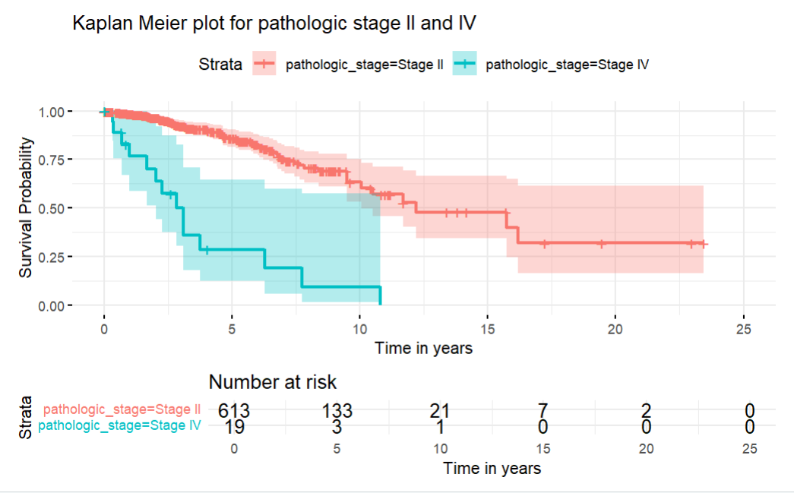
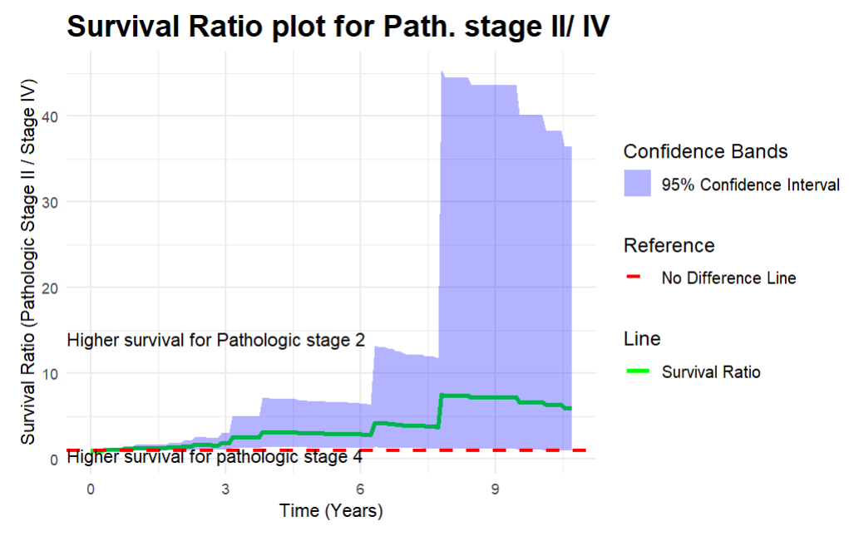
Comparison of survival between Pathologic stage II and IV

Slide 10
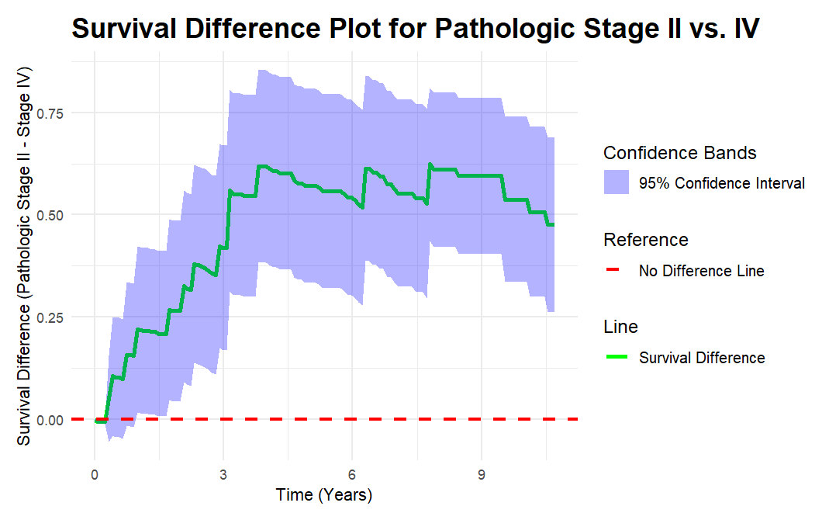

Slide 11
Comparison of survival between Pathologic stage I and II of Breast Cancer

Slide 12
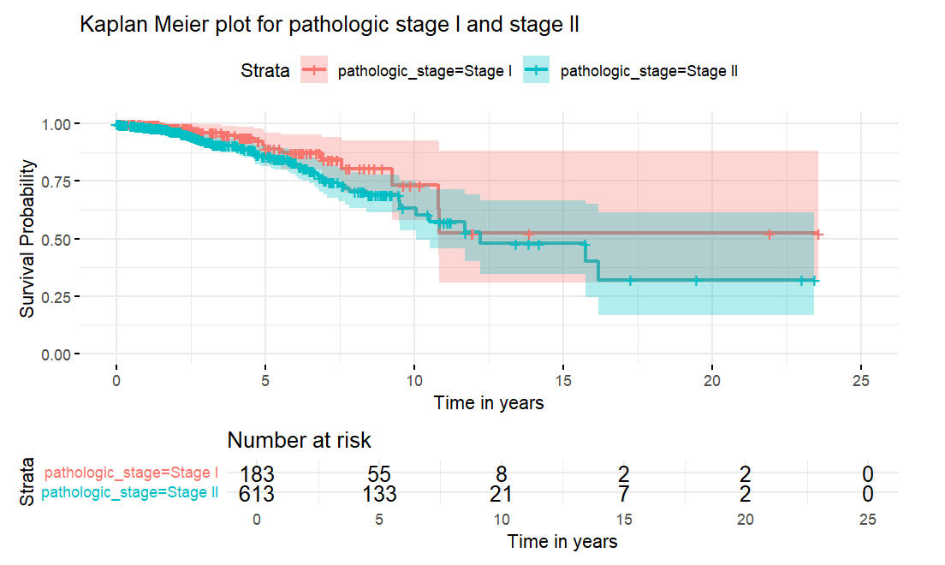
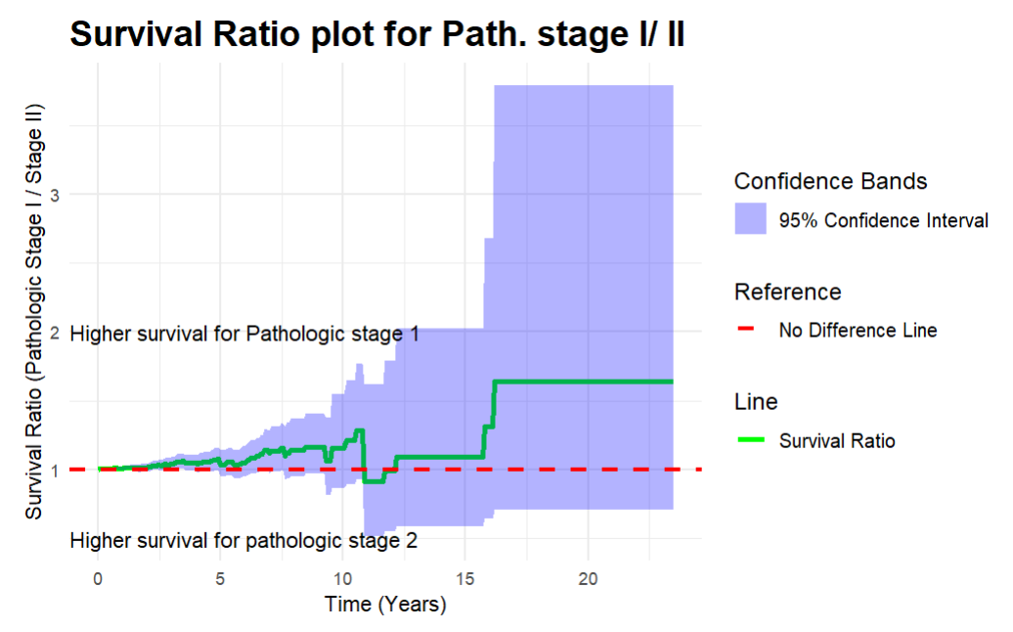
Comparison of survival between Pathologic stage I and II

Slide 13
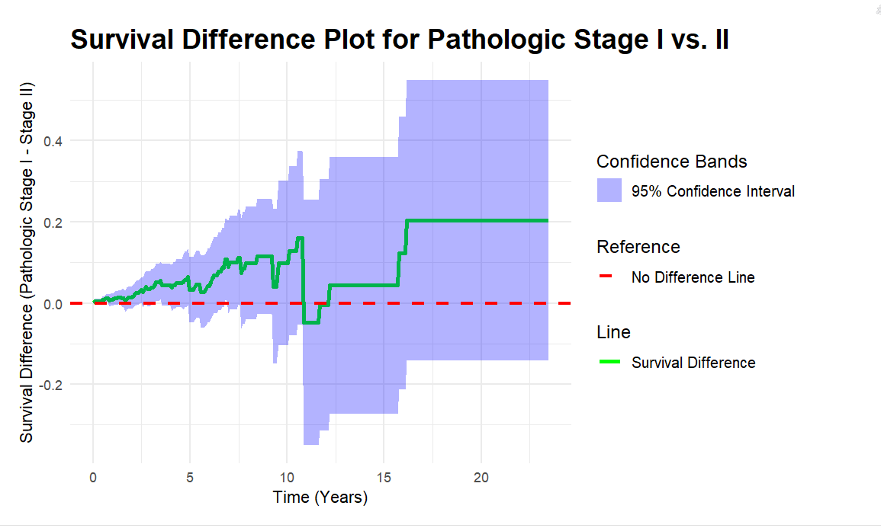
Comparison of survival between Pathologic stage I and II

Slide 14
Comparison of Survival Between White and Black race

Slide 15
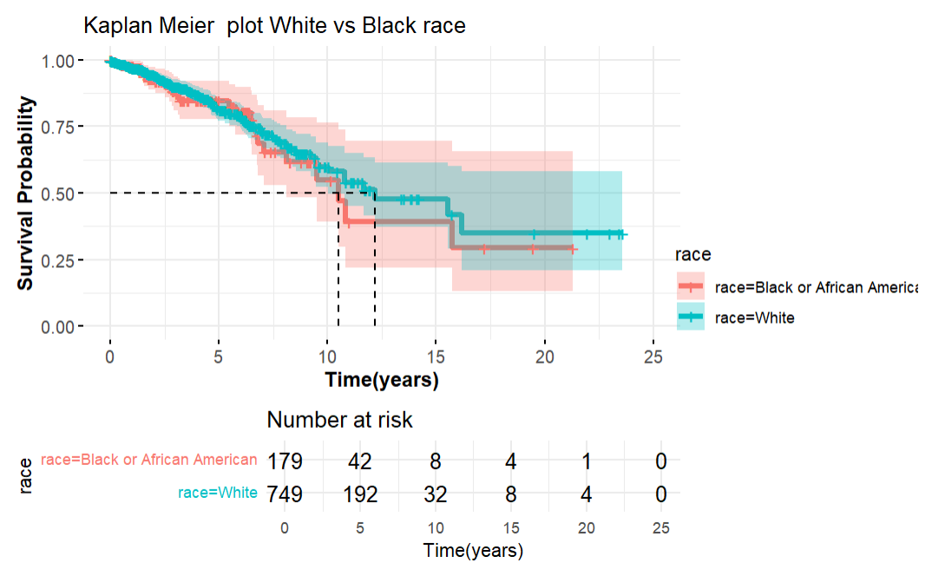
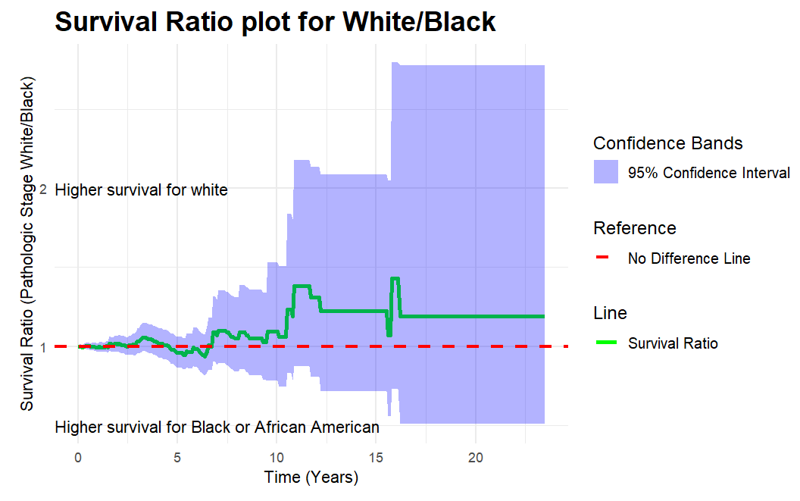
Comparison of Survival White versus Race

Slide 16
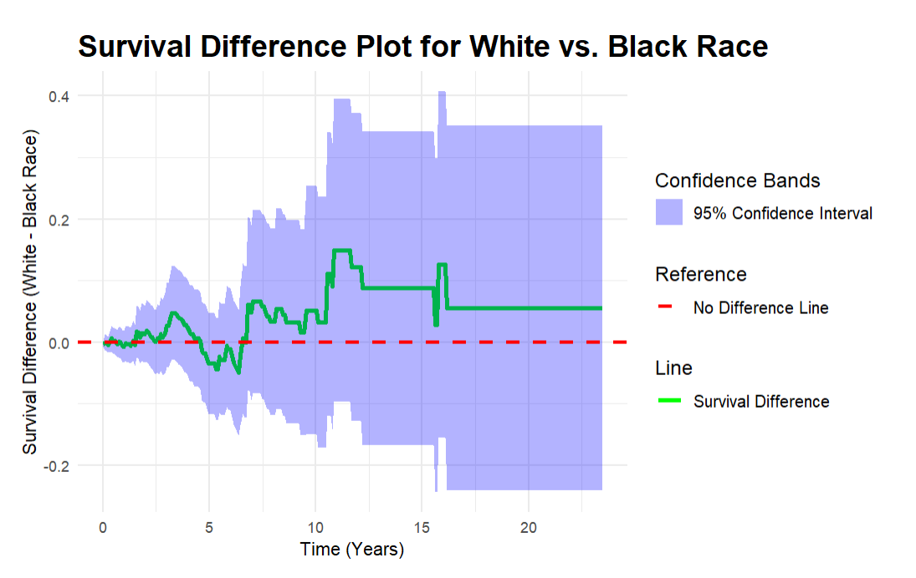

Slide 17
Comparison of survival between patients with lymph node metastasis N0 /N1

Slide 18
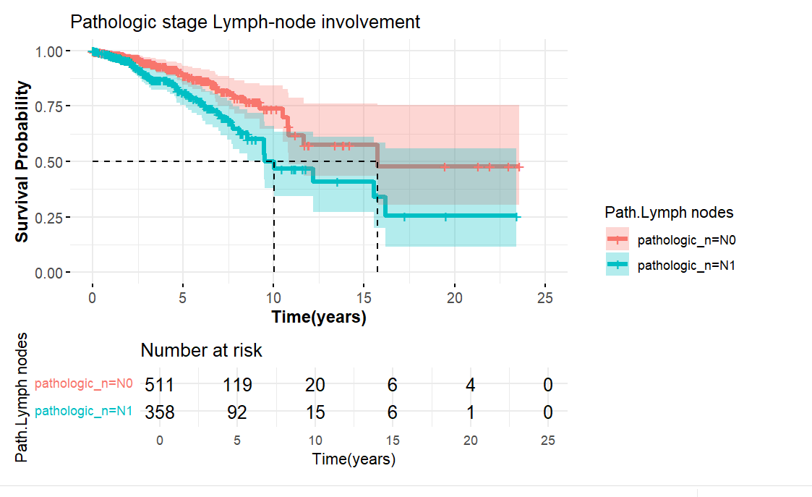
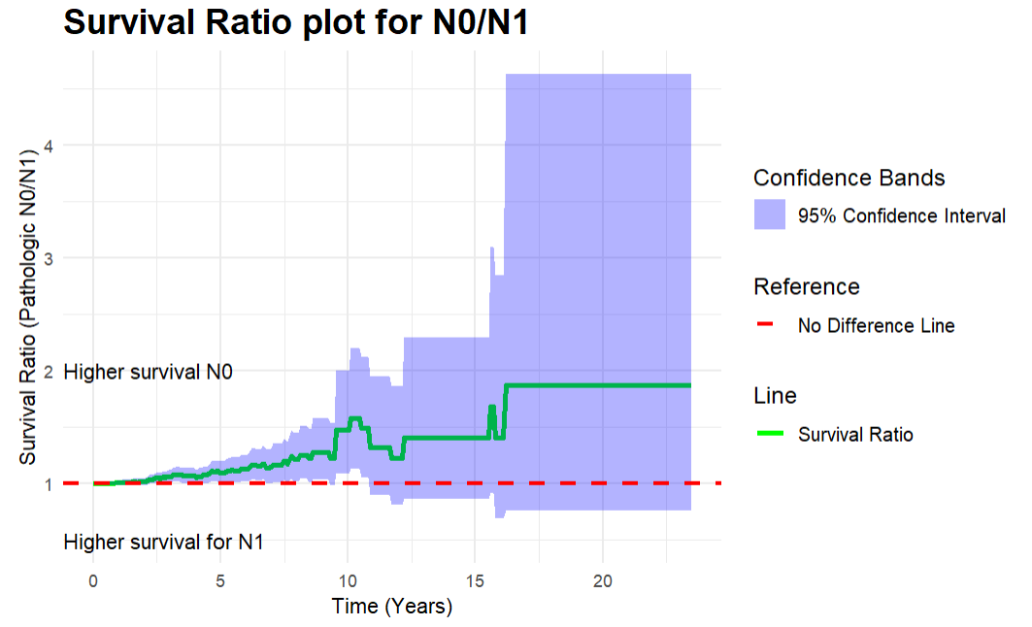
TNM N0/N1

Slide 19
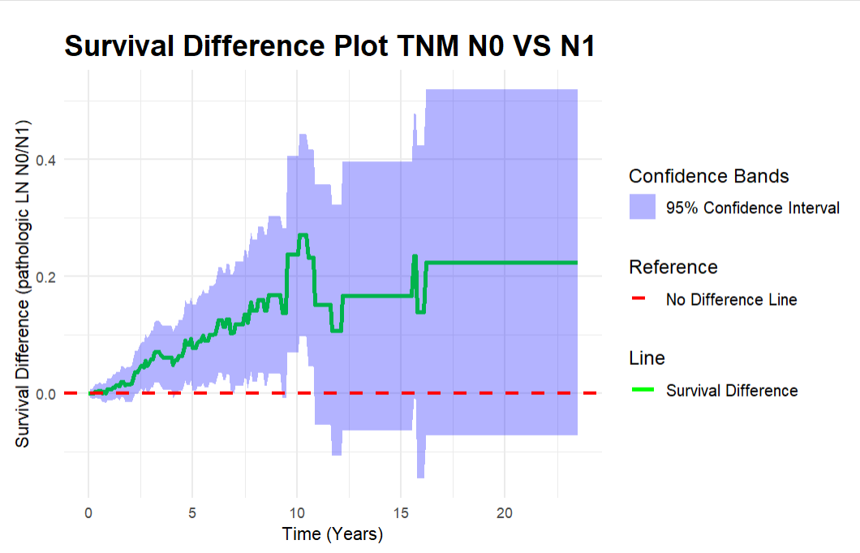
TNM(N0/N1)

Slide 20
Comparison of survival between patients with lymph node metastasis N0 /N2

Slide 21
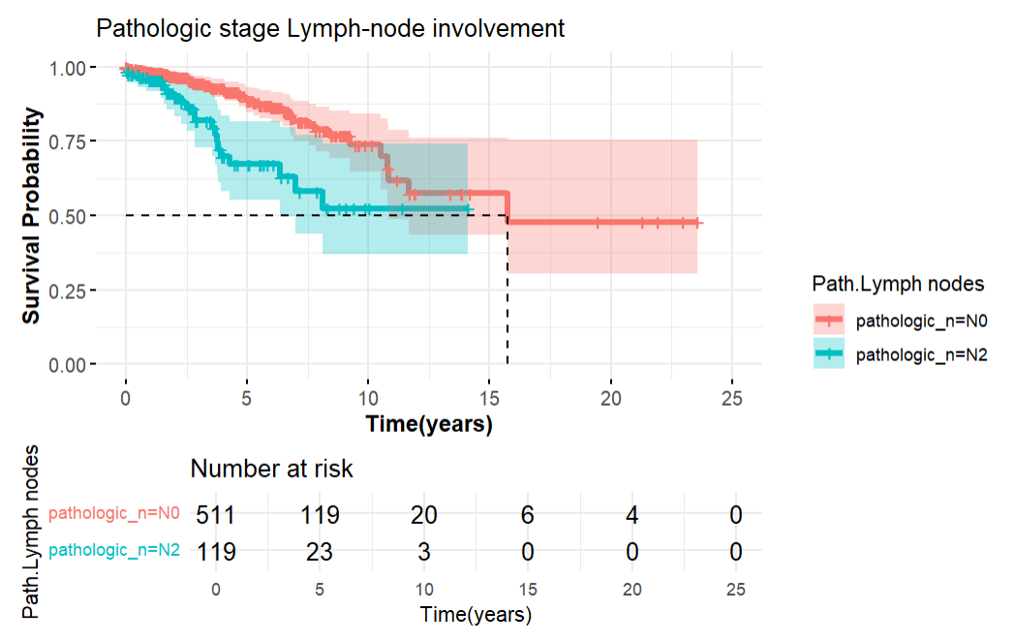
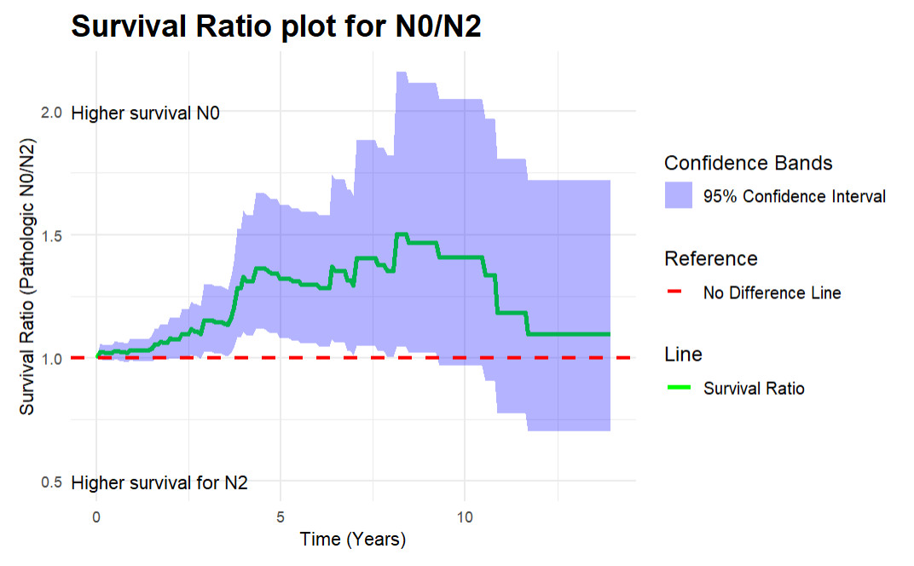
TNM(N0/N2)

Slide 22
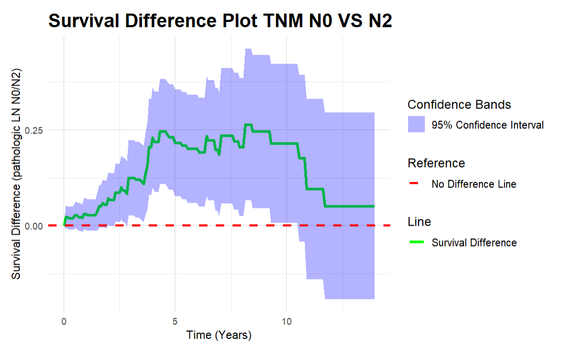
TNM (N0/N2)

